Slide 1
Simulations for Studying Cognitive Reserve Friday Harbor Advanced Psychometric Methods in Cognitive Aging Workgroup 10
Maria Glymour
Department of Epidemiology and Biostatistics
University of California, San Francisco

Slide 2
Our group goals: Learn to use simulations
A flexible, powerful tool to better:
understand statistical methods
improve communication with people in other disciplines
think clearly about your methods and whether they are answering the question you want to ask
conduct power/sample size calculations
Ask many questions you could not address with available data.
Simulations naturally link to modern causal inference methods so some of the thinking for DAGs, collider bias, and counterfactuals will be incorporated. Evaluating mediation also possible.
We’ll use Stata and R, drawing on simulation platform developed by ER Mayeda.

Slide 3
Our group goals
Answer some specific questions
If diagnosis of dementia is slightly delayed for high education individuals (because tests don’t work as well), could that account for observed cognitive reserve patterns?
If we think about preventing “dementia”, which has the biggest likely benefit: improving cognitive reserve or reducing/slowing rate of decline?
Other questions:
Role of measurement error, practice effects, and unmeasured confounding in observed results for cognitive reserve. We can simulate anything the other groups are exploring to see what analyses would “work”.

Slide 4
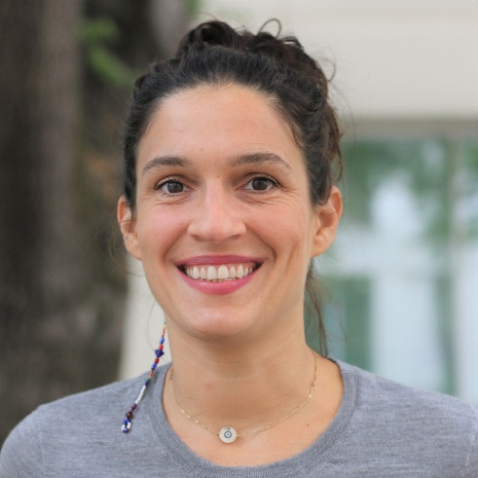
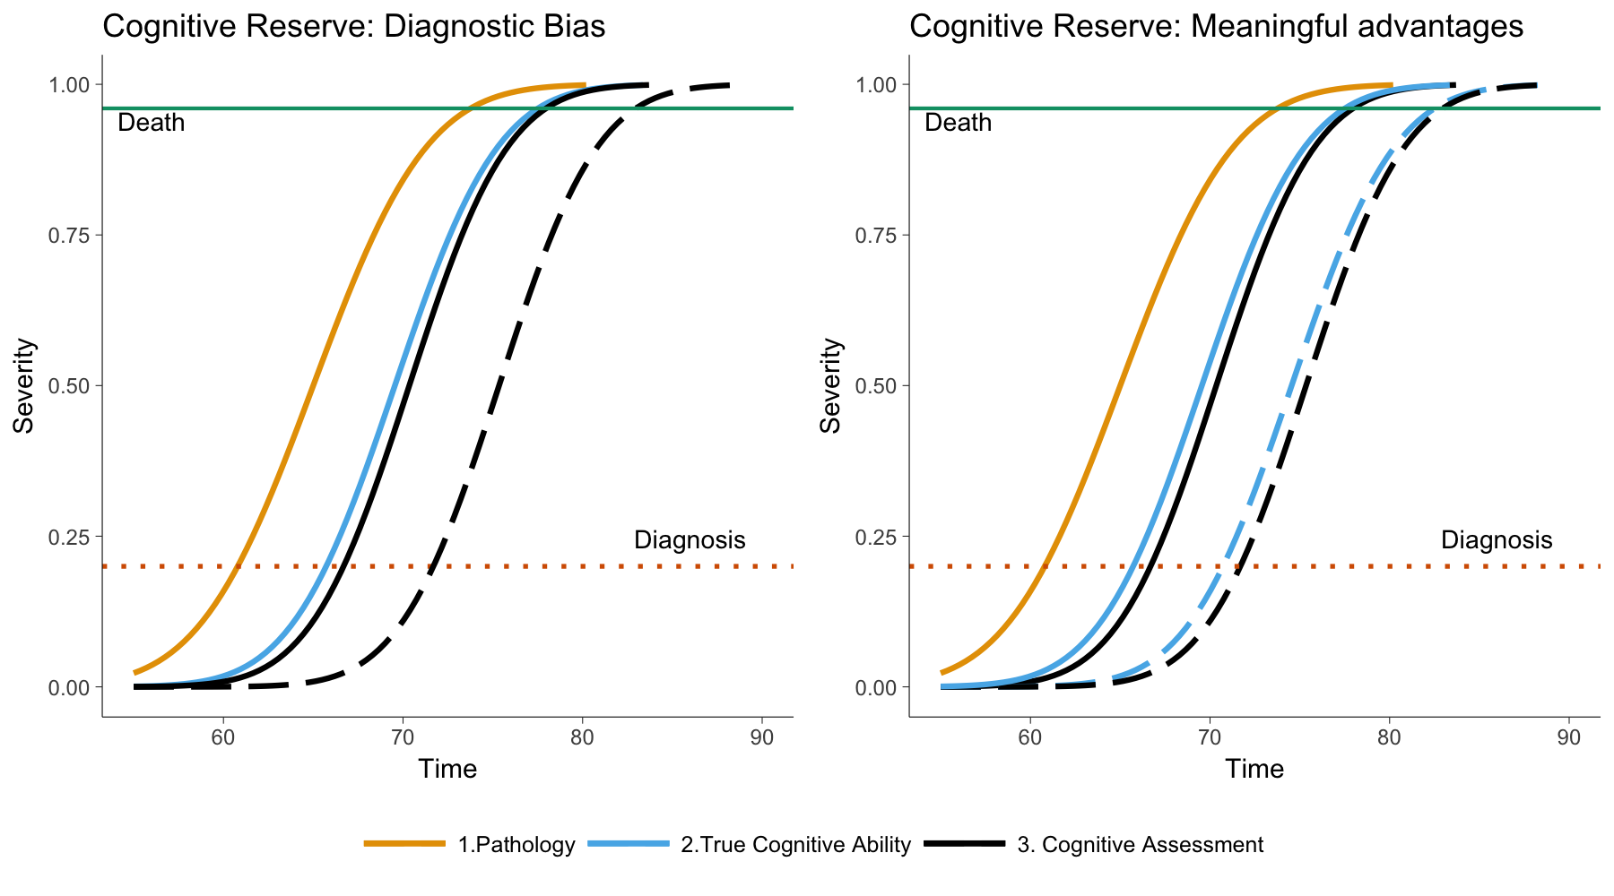
Can CR be explained by diagnostic bias?
Filshtein et al., in prep
CR delays dementia diagnosis, but possibly because of discrepancies between “true” cognition and test scores.
How much of a delay would be necessary to account for empirical patterns to date?

Slide 5
Diagnostic bias in people with high education could produce
Lower Hazard Ratio for incident dementia among people with high education
Worse prognosis among high education people recently diagnosed with dementia
Possibly: faster decline after “inflection point” to the moment of meeting diagnostic criteria for dementia
This is all mathematically possible, but unclear how big of a diagnostic bias would be necessary to explain.

Slide 6
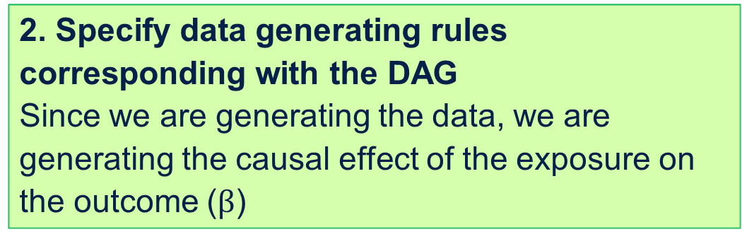
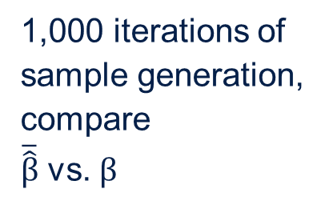
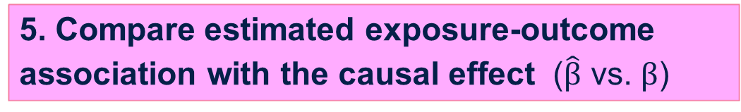
1. Express causal structure as a DAG
2. Specify data generating rules corresponding with the DAG
Since we are generating the data, we are generating the causal effect of the exposure on the outcome ($β$)
Repeat!
Varying causal structure and parameterizations
3. Generate data according to specified rules
1,000 iterations of sample generation,
compare
$\overline{\hat{β}}$ vs. $β$
4. Estimate exposure-outcome association ($\hat{β}$)
5. Compare estimated exposure-outcome association with the causal effect ($\hat{β}$ vs. $β$)
From ER Mayeda
Notes:
These steps are for one causal structure and one set of parameterizations. ..Different causal structures or different parameterizations, so often it’s useful to look across multiple scenarios

Slide 7
Advantages of Simulation Group
Extremely public health relevant.
If your brain hurts thinking about cognitive reserve estimation methods, writing out the simulations will help.
Collaborative team: we will develop cool name together.
Very flexible tool you will likely use in other settings
Settle big argument between Maria and Jen Manly.

Slide 8
Advantages of Simulation Group
Data Use Agreements are very flexible – you can take the data home with you!

